Slide 1
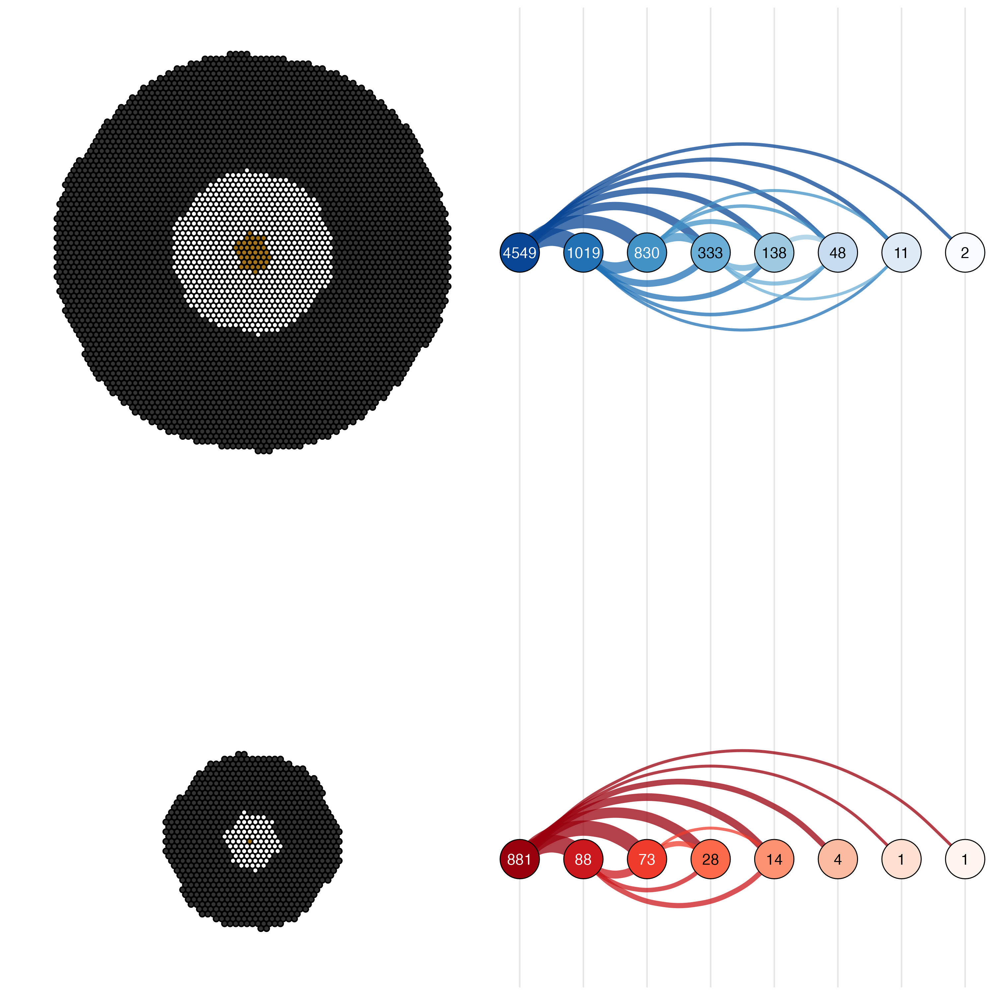
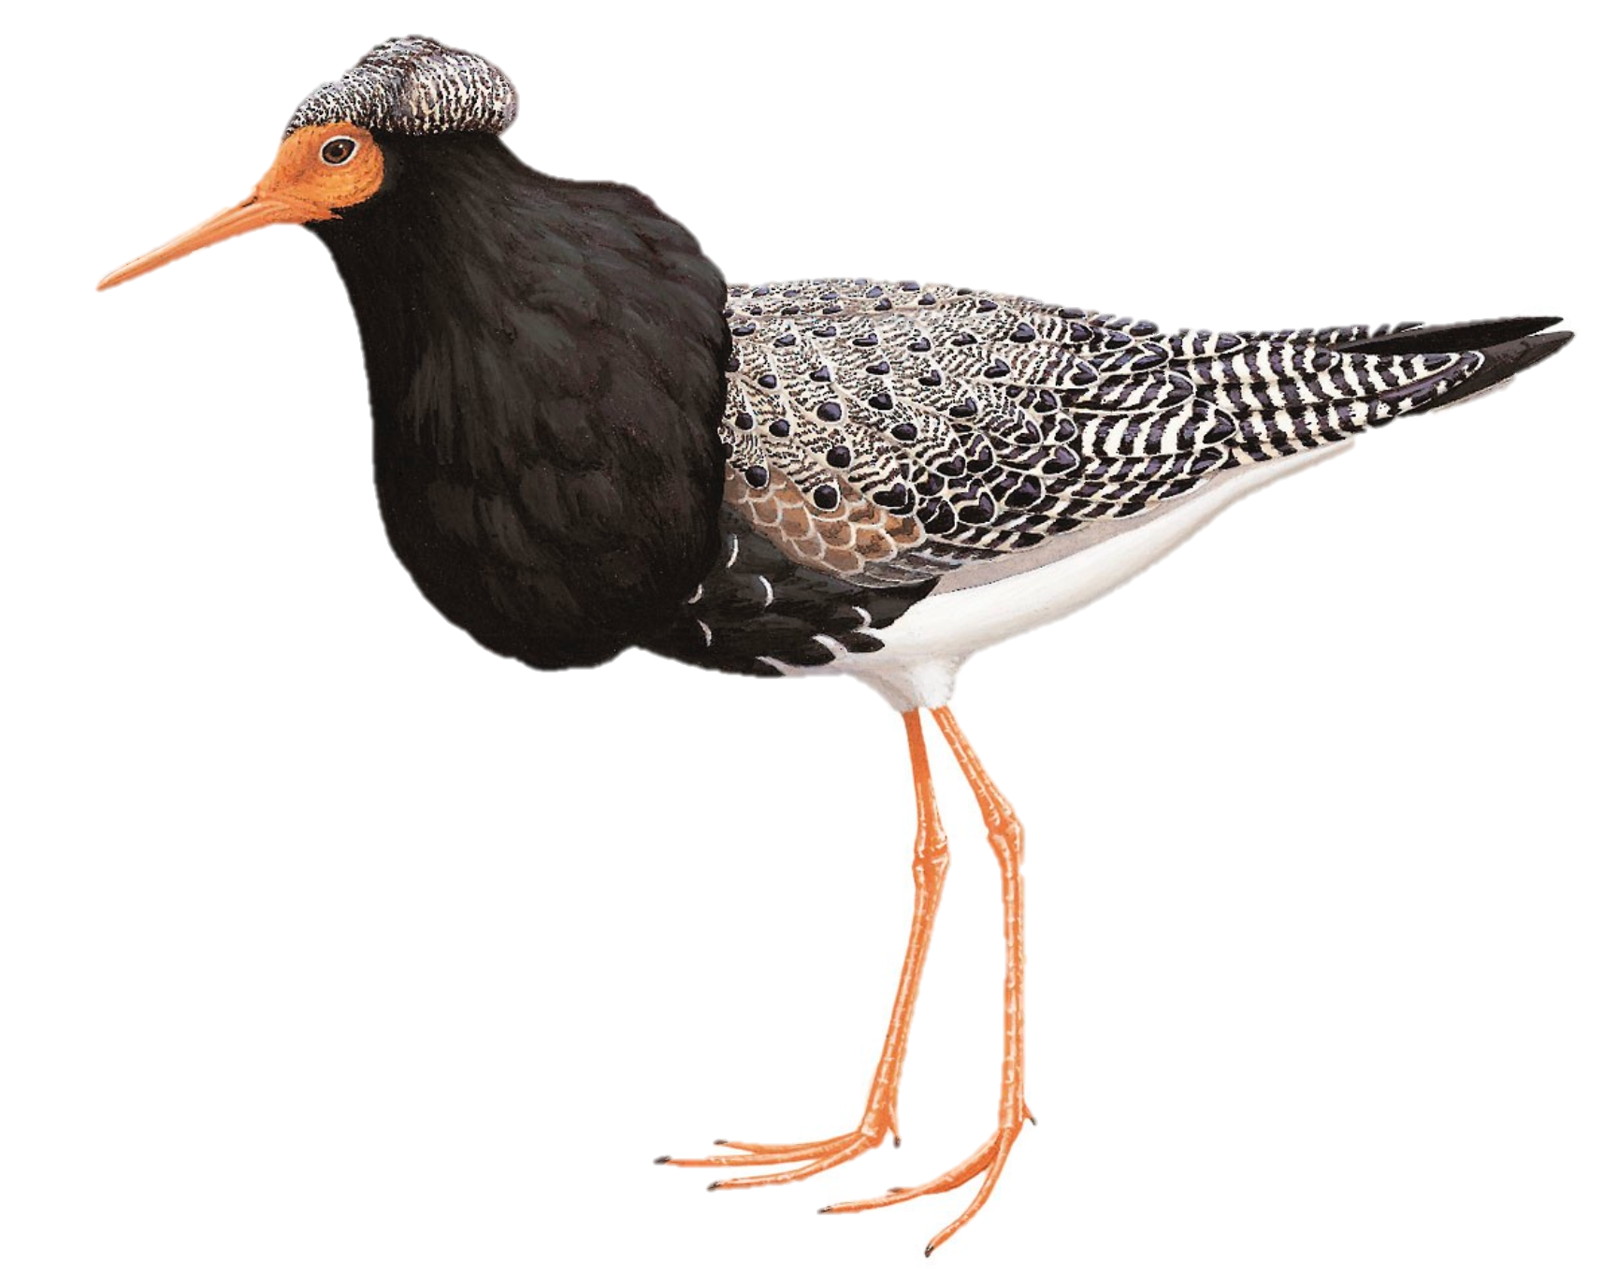
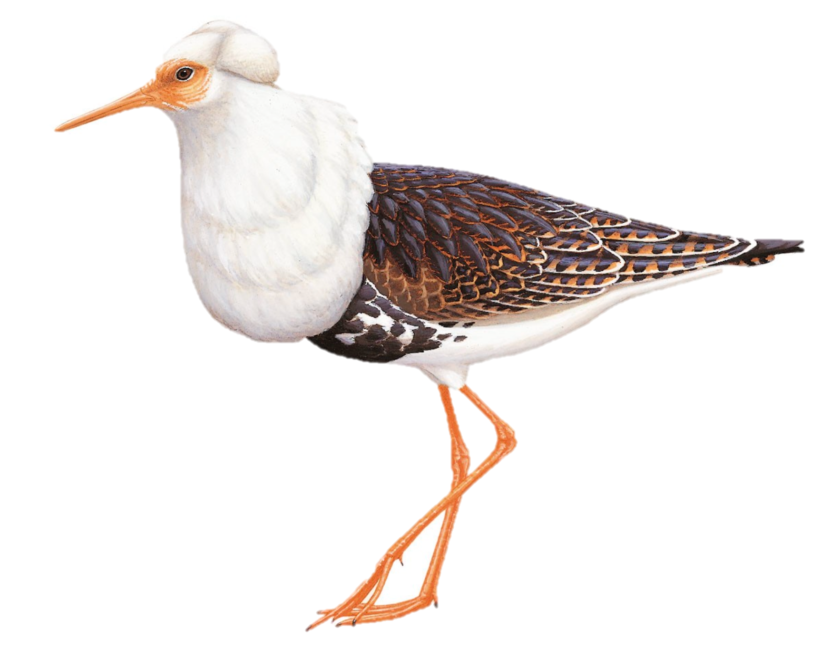
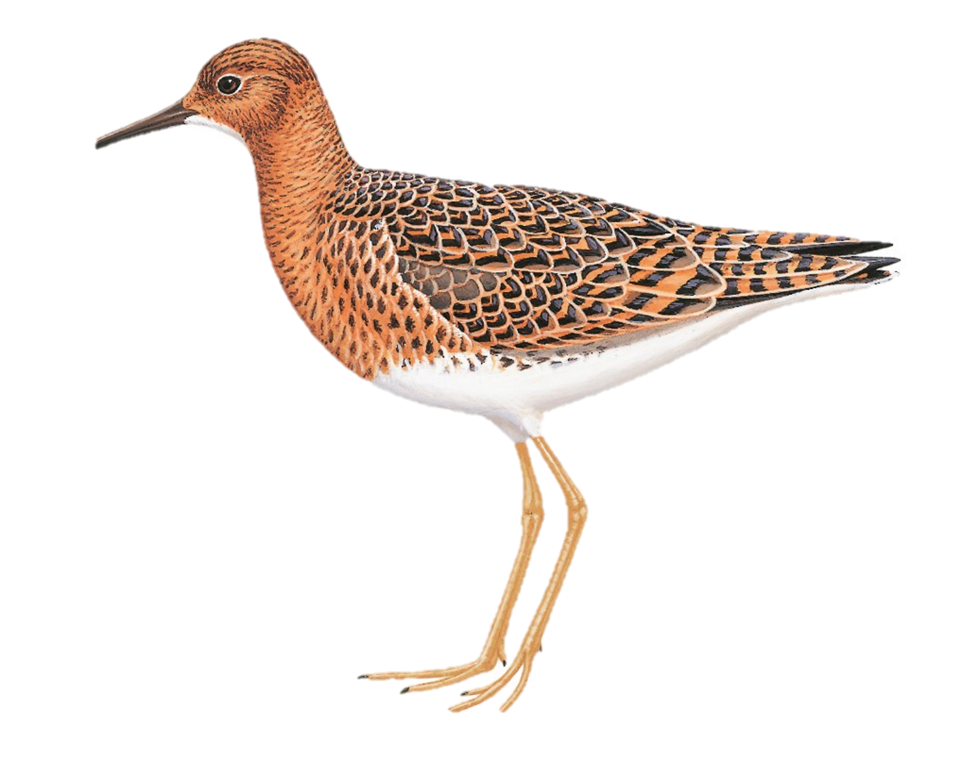
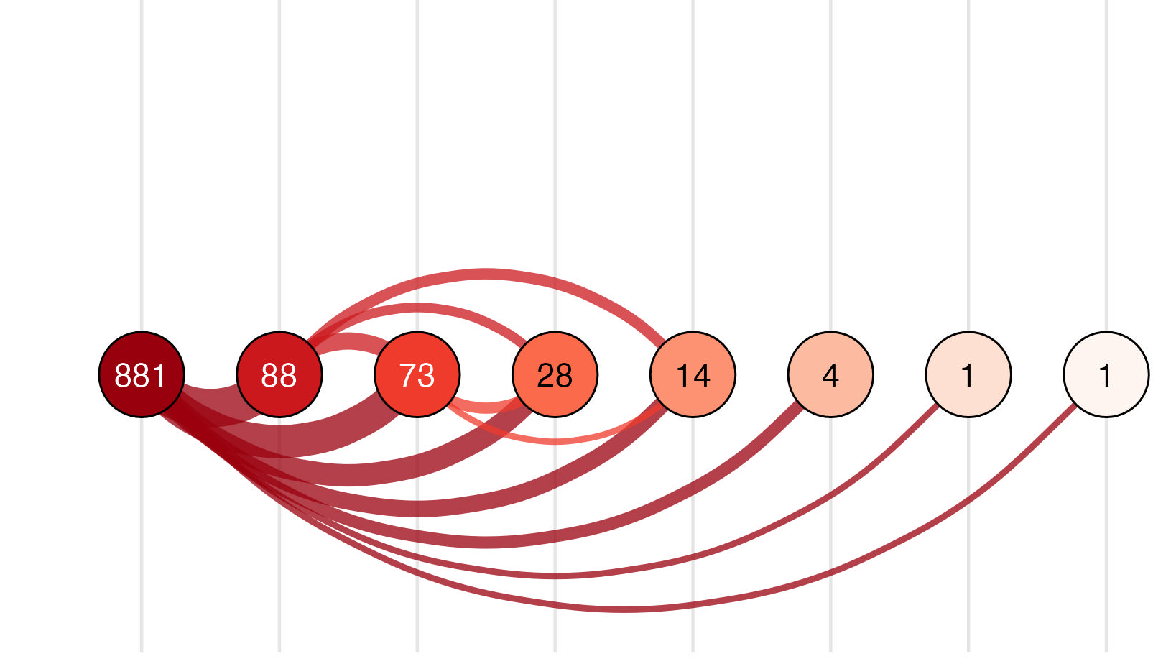
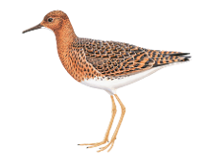
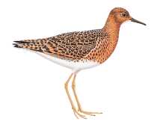
A
B
independent
N = 3,794 (83.4%)
satellite
N = 716 (15.7%)
fæder
N = 39 (0.9%)
♂
capture
encounter 1
encounter 2
encounter 3
encounter4
encounter 5
encounter 6
encounter 7
independent
N = 793 (90.0%)
satellite
N = 87 (9.9%)
fæder
N = 1 (0.01%)
♀

